Slide 1
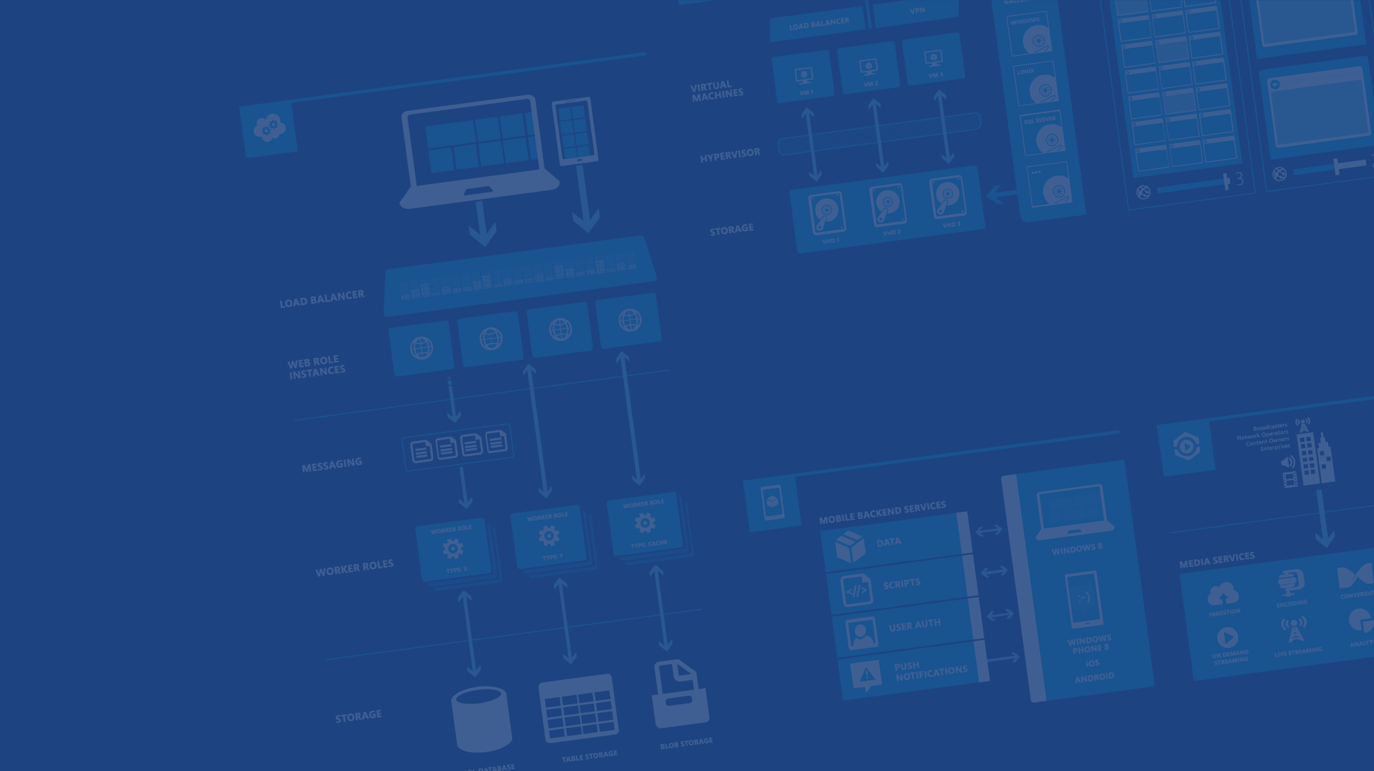
Azure Data Overview
Charalampos Karypidis
Lead Developer – DevOps
@xabikos
Microsoft Azure

Slide 2
The Cloud for Modern Business

Slide 3
Why the cloud?

Slide 4
Why the cloud?
Rapidly setup environments to drive business priorities
Scale to meet peak demands
Increase daily activities, efficiency and reduced cost.
Speed
Scale
Economics

Slide 5
Azure

Slide 6
17 regions worldwide in 2015
Azure footprint
Data Centers
Regional Partners

Slide 7
>57%
More than
1,000,000
>300k
Fortune 500 using Azure
Active websites
SQL Databases in Azure
>30
>300
>1.65
TRILLION storage objects
MILLION
AAD users
>3
MILLION requests/sec
>13
BILLION
MILLION
authentication/wk
Developers registered with Visual Studio Online

Slide 8
Azure Services

Slide 9







Microsoft Azure Services
Office Add-in
PC
Tablet
Phone
Browser
Games console
On-premises service
On-premises database
Client layer
(on-premises)
Access Control
Layer
AD
Multifactor
Authentication
BizTalk Services
Service Bus
Logic Apps
Traffic Manager
Virtual Networks
Express Route
CDN
Integration
layer
API Mgmt
Mobile Apps
Web Apps
API Apps
VM
Media Services
Notification Hubs
Scheduler
Automation
Cloud Services
Application
layer
Blobs
Tables
Queues
SQL Database
Machine Learning
HD Insight
Caching
Backup and Recovery
StorSimple
Data Layer
Storage
Data

Slide 10
Virtual Machines
Getting started
Select image and VM size
New disk persisted in storage
Management portal
Windows Server
Boot VM from new disk
>_
Linux
Scripting
(Windows, Linux and Mac)
Blob Storage
General Purpose
Basic
Standard
Optimized Compute
Performance Optimized
Network Optimized
REST API
Cloud
Comprehensive
Networking

Slide 11




Azure App Service Web Apps
Start simple
Code smart
Go live
Create new sites in seconds
Easily manage and scale your sites
Automatic load balancing and shared storage across instances
Scale out or up to reserved instances for improved performance and scale
Built-in web jobs support
Use ASP.NET, ASP, PHP, Java, Node.js, Python
SQL Database or MySQL databases
Start with open source apps and frameworks
Develop with VS and WebMatrix
Supports any Web development tool on any platform (Windows, OSX, Linux)
Rapid deployment for quick iteration
Integrated source control with Team Foundation Server (TFS) and Git
Built-in monitoring of perf and usage data
Quick access to request logs, failed requests diagnostics and diagnostics
Office Blog ASP.NET site microsoft.com

Slide 12
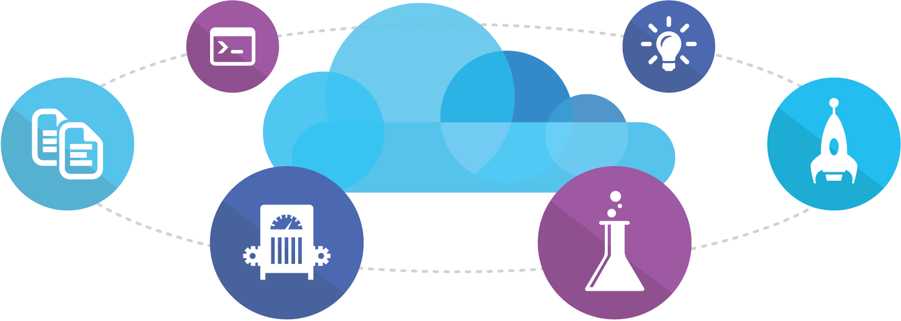
Visual Studio Online
Code
Insights
Agile
Deploy
Build
Test
Full Portal Integration
Not just for Microsoft shops

Slide 13
You
Microsoft Azure Active Directory
Synchronize your corporate and 3rd party identities
Integration with O365
Support modern protocols
OAuth 2.0
OpenID Connect
WS-Fed
SAML 2.0
Identity and Access Mgmt Permissions
Users
Groups
Applications
Microsoft Azure AD
3rd party clouds/hosting
PCs and devices

Slide 14

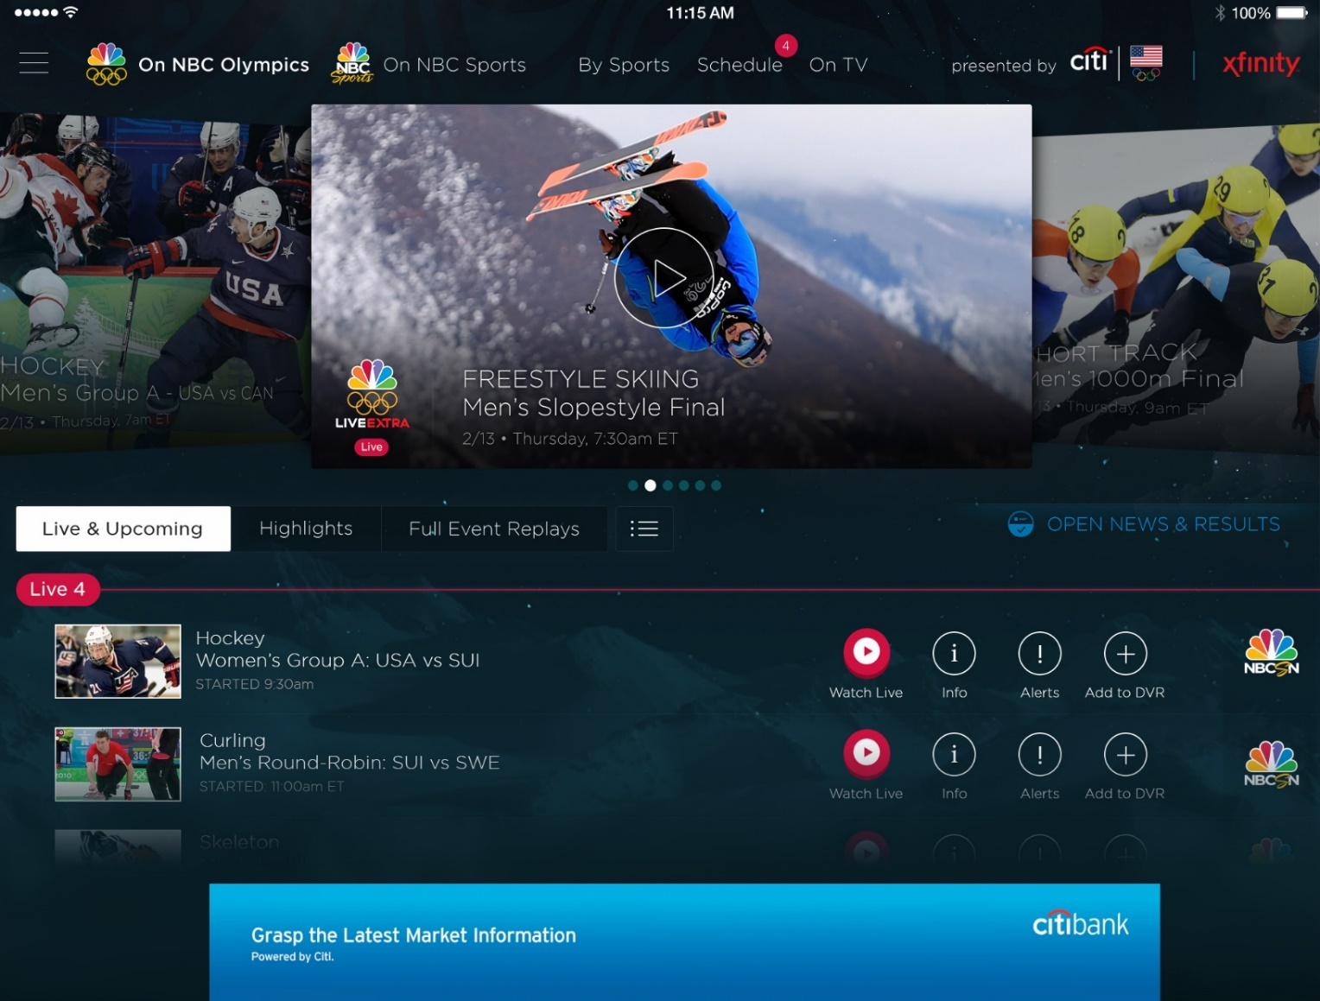
Azure Media Services
Olympics NBC Sports
On Demand Media Services
Video-on-demand
Ingest
Encode
Package
Encrypt
Delivery
Live Streaming Support
Office 365 Integration
Live video encoding and streaming
Web + Mobile
100 million viewers
2.1 million concurrent HD viewers during the USA vs. Canada hockey match

Slide 15







Azure App Service Mobile Apps
Provides essential services to support client development
Client Support
iOS
Android
HTML5/Web
Xamarin
Windows
Windows Phone
PhoneGap
Sencha
Storage
Authentication
Logic
Push
Scheduler
Notes:
Speaking Notes
Azure Mobile Services is a Backend-as-a-Service
Instead of you having to design, build, test, deploy, manage, and upgrade your whole backend, we do it for you
Features of Mobile Services
Storage – SQL DB
Authentication – built in support for social providers w/ ability to custom auth
Backend logic – data validation, logical flows, etc
Push Notifications – across all major mobile platforms
Scheduler – backend job processing

Slide 16

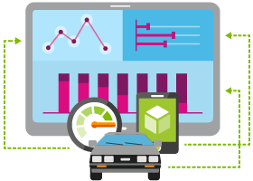





Internet of Things
Event Hubs
Notification Hubs
Stream Analytics
Machine Learning
HDInsight
Power BI for Office 365
With Microsoft Azure IoT services, you can monitor assets to improve efficiencies, drive operational performance to enable innovation, and leverage advance data analytics to transform your company with new business models and revenue streams.
Notes:
Speaking Notes
Azure Mobile Services is a Backend-as-a-Service
Instead of you having to design, build, test, deploy, manage, and upgrade your whole backend, we do it for you
Features of Mobile Services
Storage – SQL DB
Authentication – built in support for social providers w/ ability to custom auth
Backend logic – data validation, logical flows, etc
Push Notifications – across all major mobile platforms
Scheduler – backend job processing

Slide 17

Azure Stream Analytics
Event producers
Collection
Ingestor (broker)
Transformation
Long-term storage
Presentation and action
Stream Analytics
Web/thick client dashboards
Applications
Service bus
Event hubs
Azure DBs
Legacy IOT (custom protocols)
Stream processing
Search and query
Cloud gateways (web APIs)
Azure storage
Devices
Storage adapters
HDInsight
Data analytics (Excel)
IP-capable devices (Windows/Linux)
Low-power devices (RTOS)
Field gateways
Devices to take action

Slide 18









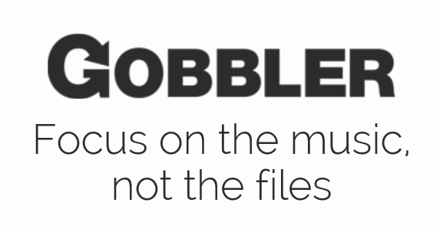














Support for Open Source
Languages
CMS
Devices
Databases / Apps
Operating
systems
Management

Slide 19
Get started today at http://azure.microsoft.com

